Slide 1
Linear Discriminant Functions
Overview
The Perceptron Algorithm
Relaxation Procedures
Support Vector Machines

Slide 2
Relaxation Procedures
The perceptron rule can be generalized using “relaxation procedures”.
Our previous crtierion function J(.) was defined as follows:
J_{p}(a) = Σ(- a^{t} y) a close variant is J_{q}(a) = Σ( a^{t} y) ²
Problems with this function:
The function is too smooth.
A solution may lie right on the boundary.
2. The function is dominated by long sample vectors.

Slide 3
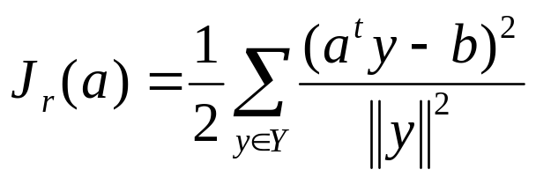
Relaxation Procedures
The problems are solved with the following function:
where the summation now corresponds to all samples for which:
a^{t} y <= b
The function is never negative and zero when a^{t} y > b.
So now we have a margin b to ensure the procedure will get into the solution area at least once.

Slide 4
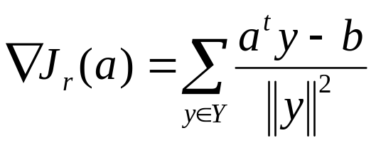
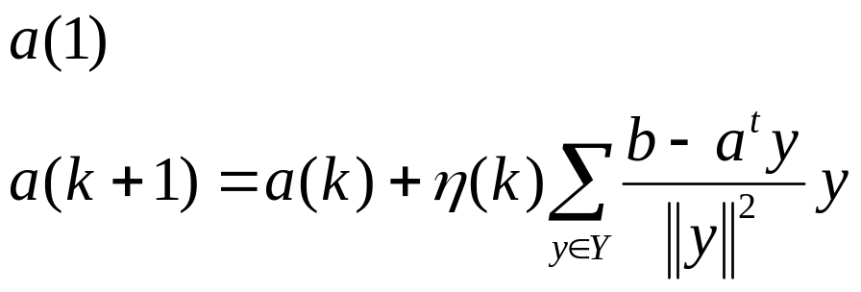
Relaxation Procedures
The gradient of J_{r} is given by:
and the update rule
arbitrary

Slide 5
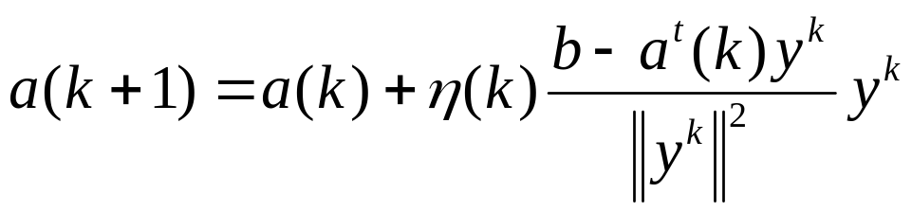
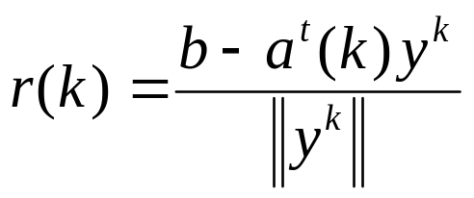
Relaxation Procedures
Single sample update rule:
(1)
is the distance from a(k) to the hyperplane a_{t}y_{k} = b.
y^{k}/||y^{k}|| is the unit normal vector for the hyperplane. Eq. (1) calls for a(k) to be moved a certain fraction η of the distance from a(k) to the hyperplane.

Slide 6
Relaxation Procedures
If η = 1, a(k) is moved exactly to the hyperplane, so that the “tension” created by the inequality a^{t}(k)y^{k}≤b is “relaxed”
After a correction,
a^{t}(k + 1)y^{k} –b=(1- η) (a^{t}(k)y^{k} –b)
If η < 1, then a^{t}(k + 1)y^{k} is still less than b, while if η > 1, then a^{t}(k + 1)y^{k} is greater than b. These conditions are referred to as underrelaxation and overrelaxation respectively. In general, we shall restrict η to the range 0 < η < 2

Slide 7
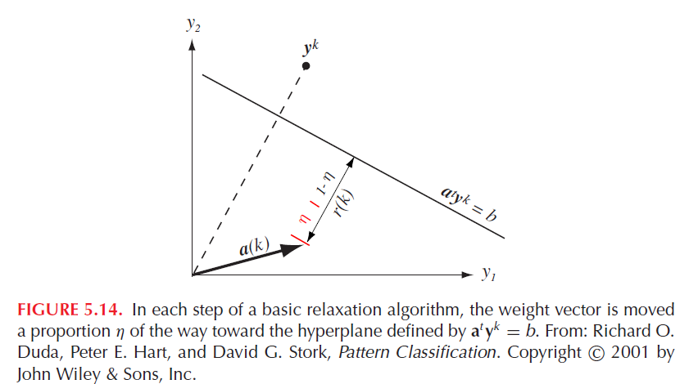

Slide 8
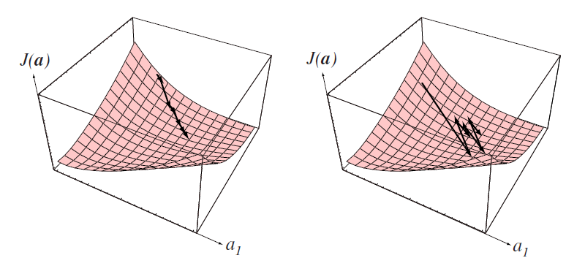
Underrelaxation and Oveerrelaxation
Underrelaxation η < 1
Oveerrelaxation η > 1

Slide 9
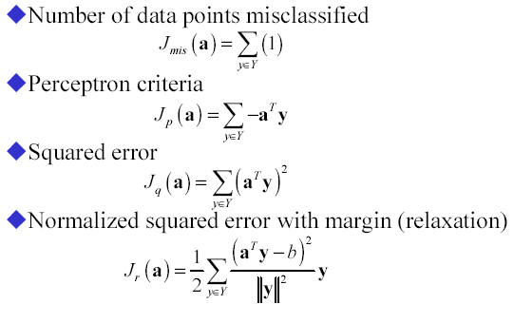
Criteria

Slide 10
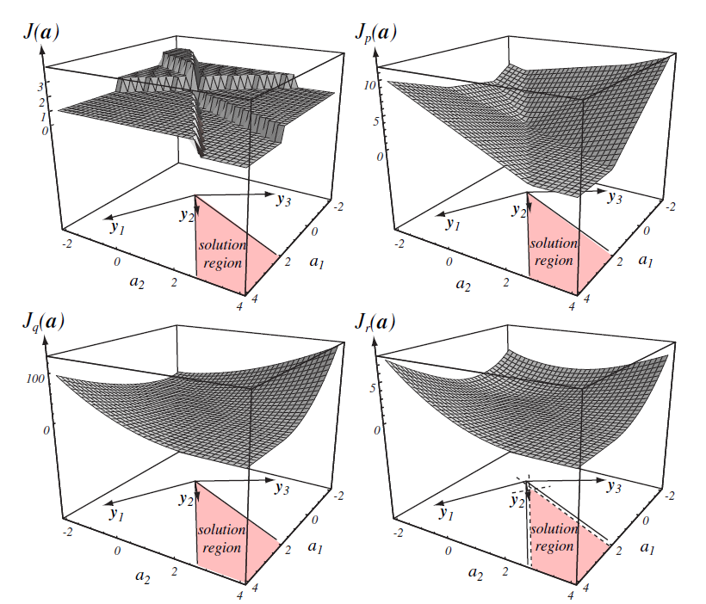
Figure 5.11

Slide 11
Nonseparable Behavior
The perceptron criterion is effective for linearly separable problems.
They look for an error-free solution. The problem we face is than in many cases datasets are not linearly separable.
One solution is to use a variable learning rate η(k). η(k) can be set to zero as k approaches infinity.
Options:
Decrease η(k) if performance improves
Set a function fro η(k) such as η(k) = η(1) / k.

Slide 12
Minimum Squared Error Procedures
Instead of focusing on only those misclassified examples we can focus on all examples.
Instead of looking for a solution where
a^{t} y > 0
Now we look for a solution such that
a^{t} y_{i} = b_{i}
The b_{i} are arbitrary positive constants.
Instead of solving a set of inequalities now we have a set of linear equations.

Slide 13
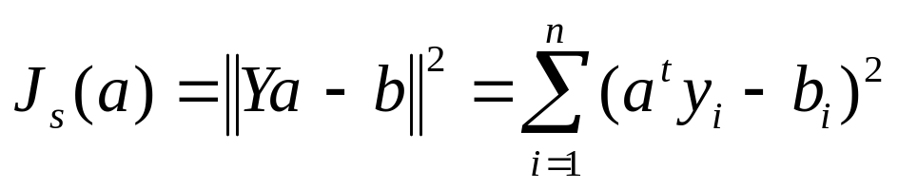
Minimum Squared Error Procedures
We want to find a weight vector a such that
Ya = b
We can define an error e by
e = Ya – b
And minimize the squared length of the error vector. In other words,we want to minimize the function:

Slide 14
Minimum Squared Error Procedures
Setting the gradient of J to zero, yield:
Y^{t}Ya=Y^{t}b
So
a=(Y^{t}Y)⁻¹ Y^{t}b=Y*b
Y* is called the pseudoinverse of Y.

Slide 15
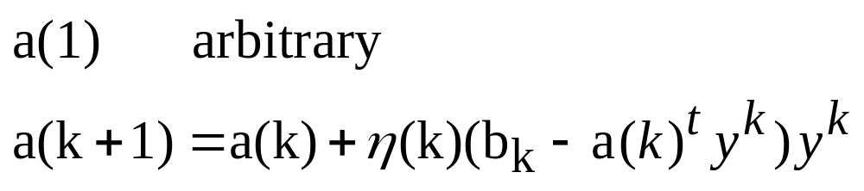
LMS
Widrow-Hoff or LMS rule(least-mwan-squared):

Slide 16
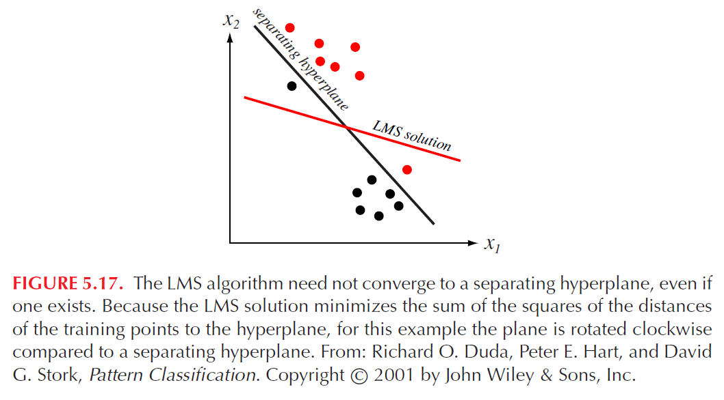
LMS

Slide 17
Support Vector Machines
The many previous methods all look for any solution to the problem of finding a separating hyperplane subject to a (possibly variable) margin. (All possible solutions will minimize the cost function.)
Support Vector Machines (SVMs) look for the best solution, the optimal separating hyperplane, typically in a generalized feature space of much higher dimension than the original feature space.
Goal: Find normalized weight vector a that maximizes the margin b.

Slide 18
Support Vector Machines
Generalized linear discriminant functions
Optimal separating hyperplane
  largest margin

Slide 19
The Transformed Space
Recall that we can define a generalized form of a linear discriminant function as:
g(x) = a^{t} y
The function is now linear on the y.
To begin, SVMs preprocess the data by representing all examples in a higher dimensional space.
With sufficiently high dimensions the classes can be separated by a hyperplane.

Slide 20
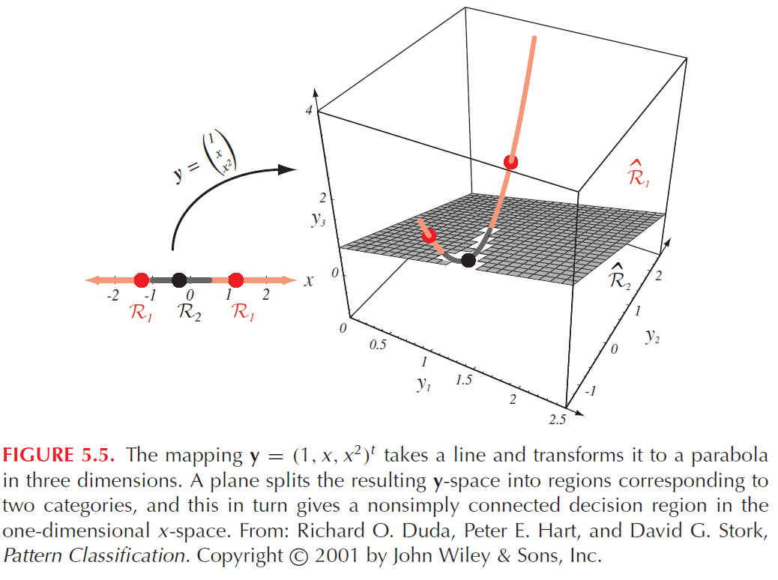
Figure 5.5

Slide 21
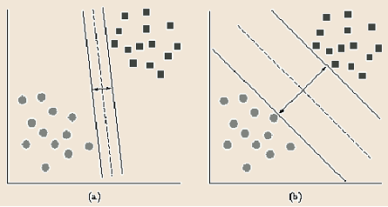
Optimal margin

Slide 22
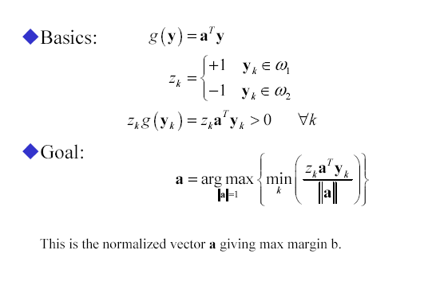
The Goal in Support Vector Machines

Slide 23
The Support Vectors
Notice that if the parameter a is scaled, the decision surface is unchanged.
Scale solution vector a, a separating hyperplane ensures that:
z_{k} g(y_{k}) >= 1
Now the distance from a pattern y to a hyperplane is g(y) / ||a||.
Hence, we want to find a vector a that maximizes margin b in the equation:
z_{k}g(y_{k}) / ||a|| >= b

Slide 24
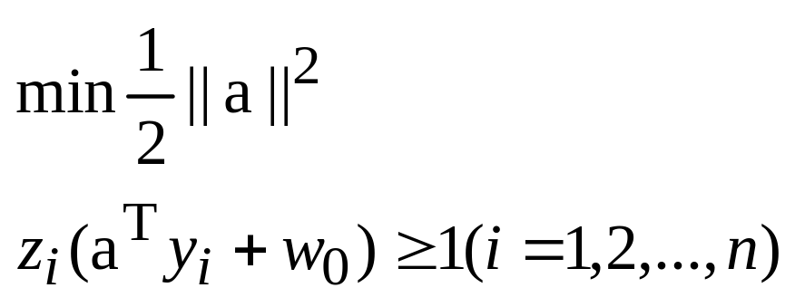
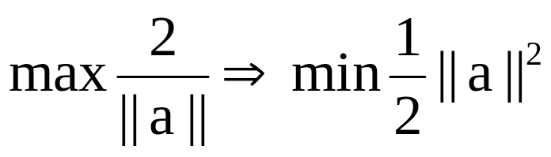
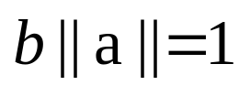
The Support Vectors
Given g(y)=a^{t}y+w₀ , to find a vector a :
The solution that maximizes margin b also minimizes ||a||.

Slide 25
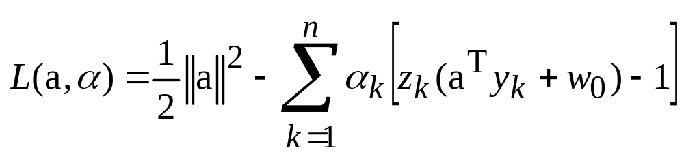
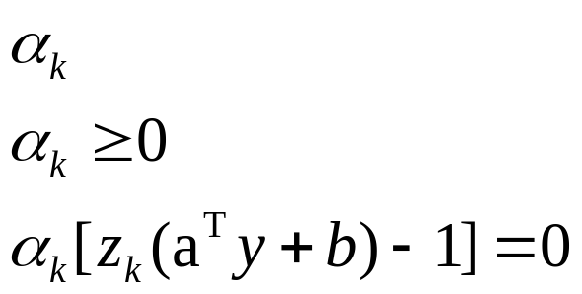
The Support Vectors
One possible aprroach to solving this problem is through Lagrange Multipliers
s.t. Kuhn-Tucker conditions

Slide 26
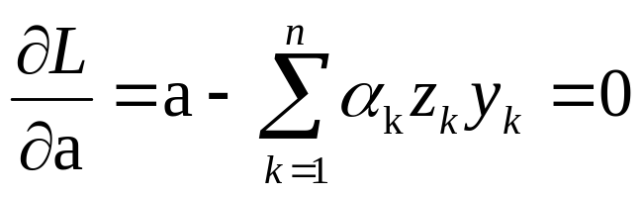
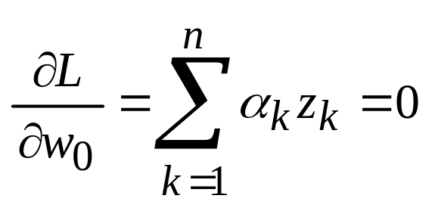
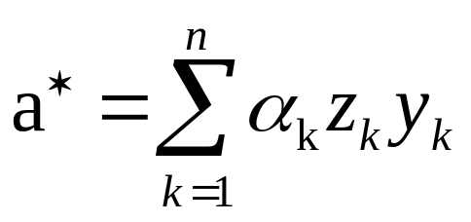
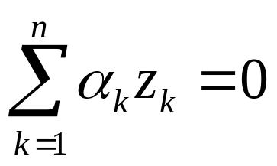
Kuhn-Tucker algorithm

Slide 27
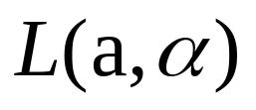
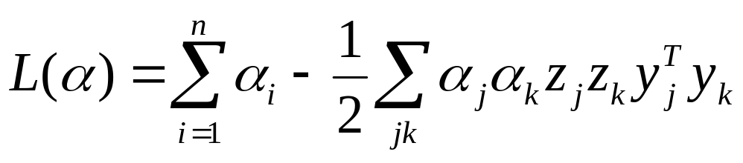
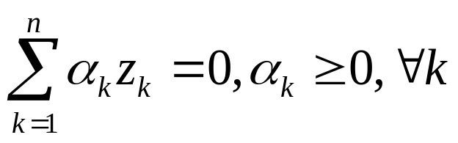
Kuhn-Tucker algorithm
Reformulate
With
Typical solution method: quadratic programming

Slide 28
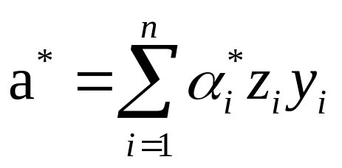
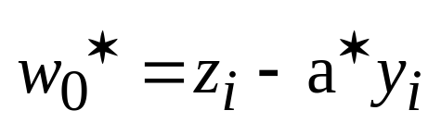
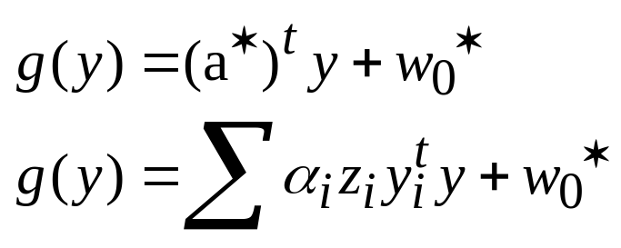
The Support Vectors
If α* is the optimal solution,then
and non-zero α_{i}* satisfy α_{i}(z_{i} g(y_{i}) – 1)=0

Slide 29
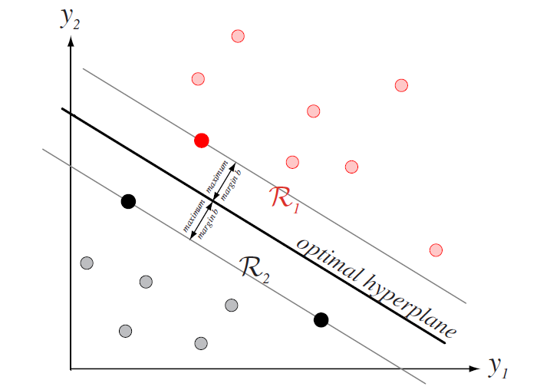
Key factor in SVM algorithms: Only the data actually touching the margings matters for identifying the optimal hyperplane. These points are called the support vectors.
The complexity of the classifier is a function of the number of the support vectors..

Slide 30

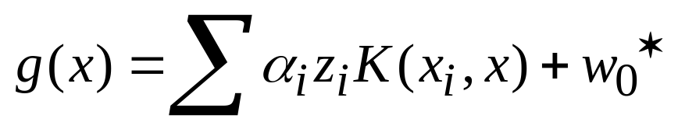
Kernel function
Another key property of the SVM is that the only quantities that one needs to compute are scalar products of the form x^{T}y.
It is therefore convenient to introduce the so called kernel function K(x,y)
so

Slide 31




Kernel function
1. Linear Kernel
2. Polynomial Kernel
3. Gaussian Kernel
4. Radial basis function Kernel
5. Sigmoid Kernel

Slide 32
An Example
The XOR problem is known to be nonseparable:
x2
1
0
-1
-1 0 1
x1

Slide 33
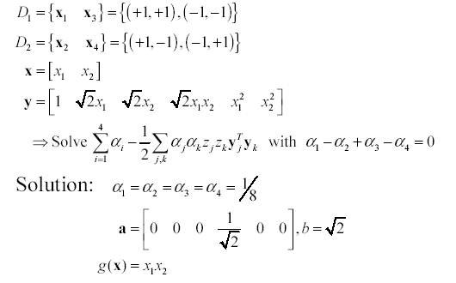
An Example

Slide 34
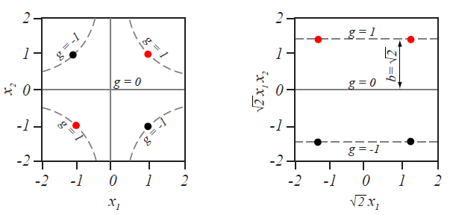
An Example
1.41 x1x2
1
b = 1.41
0
g = 0
-1
-1 0 1
1.41 x1

Slide 35
Benefits of SVMs
Benefits:
The complexity of the classifier is based on the number
of support vectors rather than the dimensionality of the
feature space.
This makes the algorithm less prone to overfitting

